Slide 1

Show Me the MONEY!
Notes:
Did you know there is a scholarship for someone who is great at duck calling? For being passionate about skateboarding or for majoring in bag piping? Just for being tall? Or how about $27,500 a year to live in J.D. Salinger’s former dorm room and display “quirky brilliance”?
These are all REAL scholarships, and I’m here to show you how you can find a scholarship that is right for you, no matter who you are!

Slide 2


Slide 3
What is Financial Aid?
Funds provided to students and families to help pay for postsecondary education.
  Scholarships
  Grants
  Loans
  Employment/Work-Study

Slide 4

What are Scholarships?
Free money!
You don’t have to pay to get scholarships.
Scholarships don’t need to be repaid.
Usually applied directly to tuition/living expenses.
Scholarships are a form of gift aid
Notes:
First let’s start with what are scholarships and what are they used for. Scholarships are a form of financial aid, and they are FREE. You do not have to pay to get them, and you do not have to repay them either, which is why they are sometimes referred to as a type of “gift aid.”

Slide 5

Who can get a Scholarship?
You!!
Notes:
So who can get a scholarship?
There are scholarships available for every kind of student, including you! I’m here to give you all the tools you need to find and apply for them, then it’s up to you to put in the work of getting them!

Slide 6

You can get a scholarship based on:
Your qualities
Your achievements
Your luck

Slide 7

One or more of these criteria, and many, many more:
Your income level (Completed FAFSA usually required)
Your heritage or religion
Where you or your parents work
Your hobbies or interest
Your intended major
Where you live
Community service
Where you are going to college
A disease or disability diagnosis you may have
Overcame adversity
Notes:
When someone decides to create a scholarship, they can award it based on any criteria they want! That means the possibilities are endless!

Slide 8

Your achievements
Artistic
Volunteer
Other
Academic
Athletic
Musical
Notes:
When most people think of scholarships, they think of scholarships based on earning good grades or being an outstanding athlete. And scholarships absolutely can be based on these achievements and many others, including musical talent, artistic ability, volunteer work, or any other achievements

Slide 9
Wacky & Unusual Scholarships
Being left handed
Making your prom dress out of duct tape
Promoting vegetarianism
For being the child of a Tupperware salesperson.
For duck calling
Being passionate about skateboarding
Notes:
There are plenty more where these come from, so just remember that scholarships are awarded for thousands of reasons, and to all kinds of students, and that there is a scholarship out there for you. You just have to find it!

Slide 10

Why should you look for scholarships?
Notes:
You may be wondering why you should bother searching and applying for scholarships. Why should you?

Slide 11

It’s worth your time!
1 $10,000 scholarship won
5 hours spent applying for scholarships
= $2,000 per hour!
Notes:
If you’re successful, applying for scholarships can be well worth your time. Let’s say that it takes you five hours to complete a dozen scholarship applications, and you win just one of those scholarships. But it’s a $10,000 scholarship. And five hours for a $10,000 scholarship equals $2,000 an hour!

Slide 12
Reduce out-of-pocket college cost and debt
$10,000 Scholarship
$10,000 Federal
Student Loan
$10,000 Credit
Card Debt
$0 in interest and $0 to repay
x 6.8% interest = $680 per year
x 4 years of college =
$2,720 in interest & $12, 720 to repay
x 19% interest = $1,900 per year
x 4 years of college =
$7,600 in interest & $17,600 to repay
Notes:
Scholarships also reduce the total out-of-pocket cost of college to you, reducing how much other financial aid you will need to find or how much your family will need to pay out-of-pocket. Plus, it will reduce your need to borrow student loans, allowing you to leave college with a lighter debt load.
Remember that $10,000 scholarship you won after completing a dozen applications? If you instead borrowed that money through a federal student loan program, you’d end up owing almost $3000 just in interest before you even left college! And if you put it on your credit card at 19% interest? That’s over $7,500 in interest in four years.
You can see that scholarships are the way to go!

Slide 13
Where do you find Scholarships?
Internet Websites
FastWeb.com
Scholarships.com
CollegeBoard.com
FinAid.org
Meritaid.com
Scholarshipjunkies.com
Scholarship Books
Local Library
Bookstores
Counseling Office
Military
GI Bill
ROTC Scholarships
High Schools/Colleges
College Scholarship Offices
Counselors and Advisors
LHS Counseling Website
Local Community
Stores and companies (Kohls, Target, Coca Cola, Toyota)
Hospitals
Community organizations
Religious institutions

Slide 14
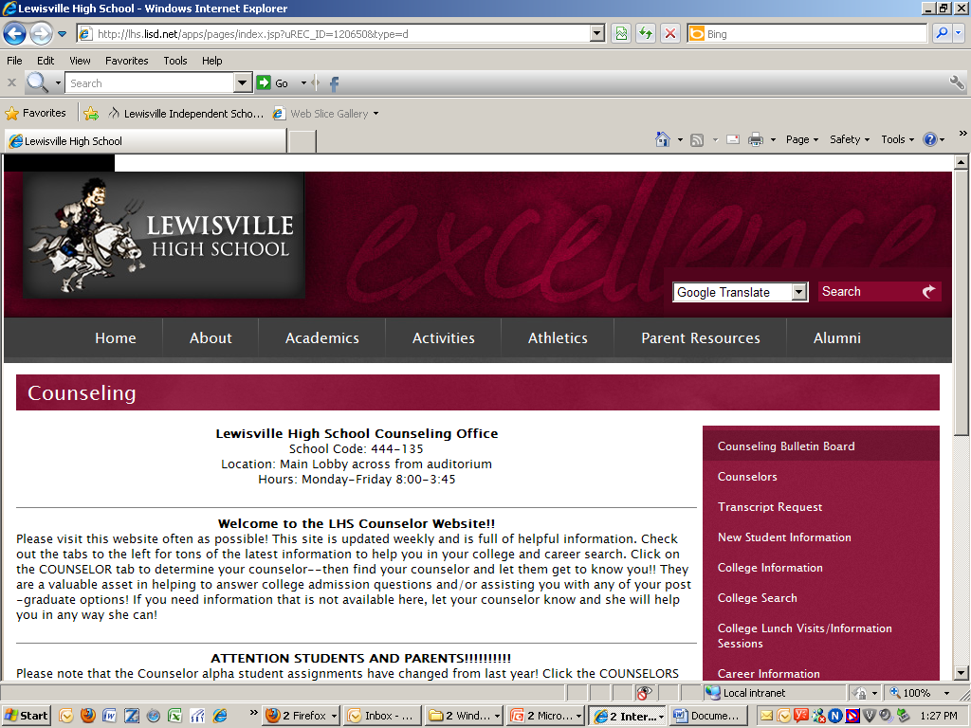
Notes:
Most counseling offices keep a listing of scholarships. Our is posted on our website Also, be aware that new information on scholarships is available all the time, so keep checking back.

Slide 15
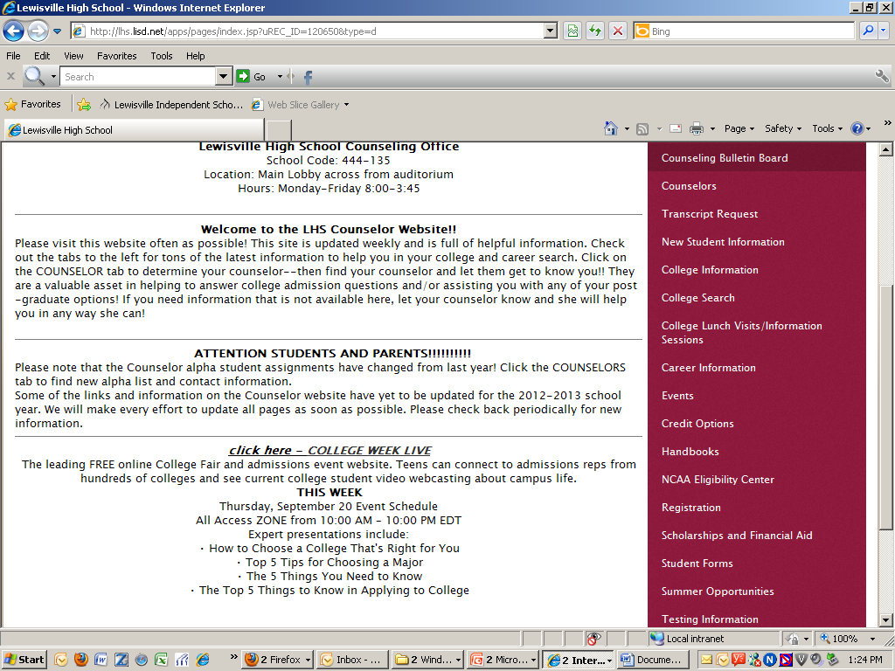
Scholarships and Financial Aid

Slide 16
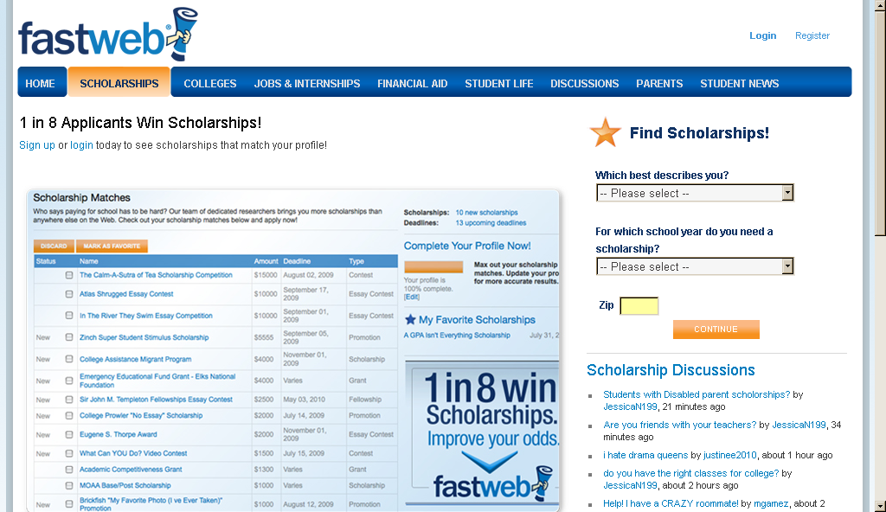
Fastweb
Notes:
Many students wonder what the steps are to doing an online search. Let’s go through the collegeboard.com site as an example. When you select “Scholarship Search” you’ll have the opportunity to provide information about yourself that could match you up to a scholarship. The questions will include things like your state of residence, minority background, and any disabilities you might have.
Once you’ve done that, you’ll be given a list of possible scholarships, and their basic information. At that point, it’s up to you to learn about each scholarship through the links provided. Do you really qualify? Many scholarships will have restrictions like what area you will be studying or what college you’re attending.
When you narrow down the list of possibilities to those for which you qualify, you’ll want to then obtain and complete each scholarship’s application process. This involves time and hard work, as each scholarship will have different requirements, so be careful to read and follow all the directions. We’ll talk more about successfully completing scholarship applications next-- including doing a Personal Assessment and creating an Academic Portfolio to make the process easier.
Keep in mind that completing an online search for scholarships is a separate process from completing the actual scholarship applications.

Slide 17
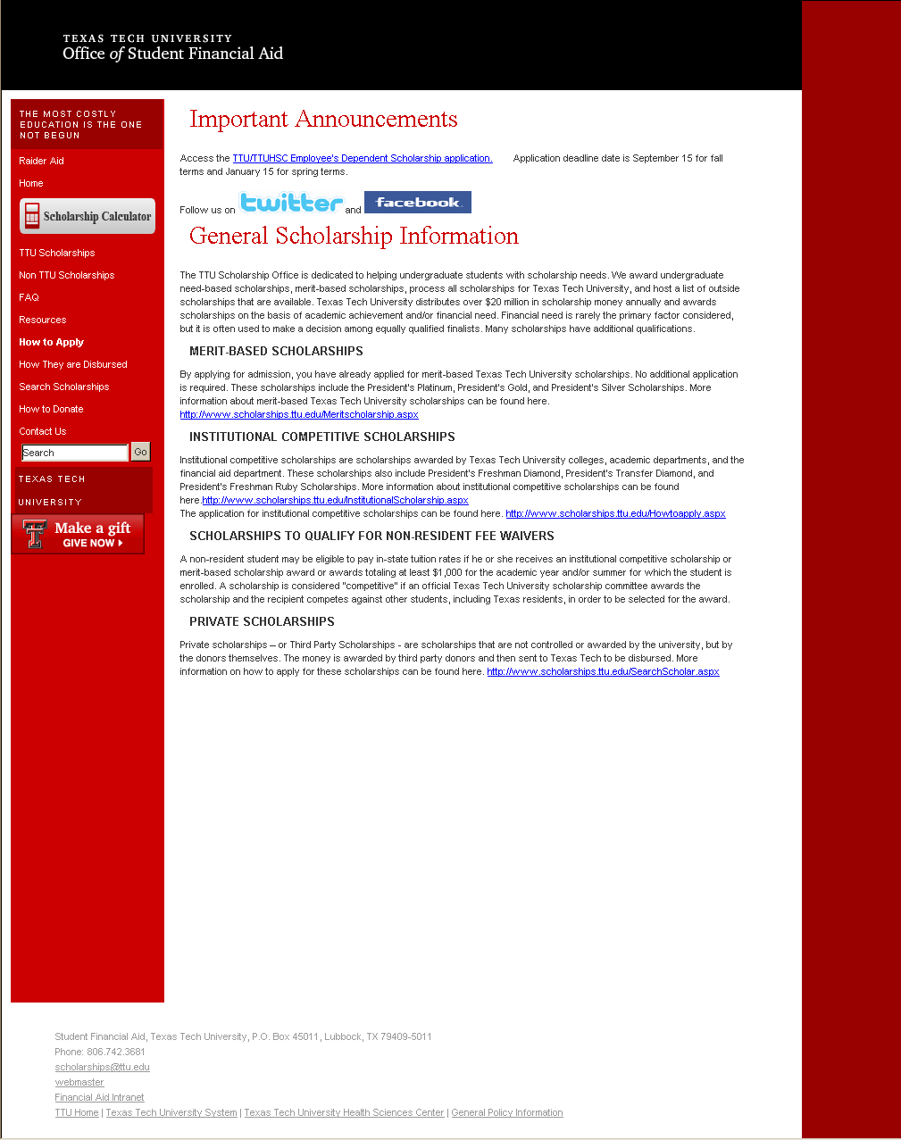

Slide 18
How do I choose which Scholarships to apply for?
Choose applications based on how well they fit you
Evaluate how well your profile fits the scholarship criteria
Apply for everything local; small applicant pools increase your chances – specifically LISD Education Foundation

Slide 19
What does a scholarship winner look like?
Find award winner profiles on scholarship’s site.
Visit www.scholarshipjunkies.com to see profiles of students who have had scholarship success.
Learn from those who have received the scholarships
  What did they do?
  Read their essays & profiles
  Talk to them

Slide 20
Grants
Money that does not have to be paid back.
Usually awarded on basis of needed.
Receive from federal, state and college.

Slide 21
Loans
Money students and parents borrow to help pay educational expenses
Repayment usually begins after education is finished
Only borrow what is really needed
Look at loans as an investment in the future

Slide 22
Employment/Work-Study
Allows student to earn money to help pay educational costs
A paycheck
  Non-monetary compensation, such as room and board

Slide 23
Free Application for Federal Student Aid (FAFSA)
A standard form that collects demographic and financial information about the student and family
Information used to calculate the Expected Family Contribution or EFC
  The amount of money a student and his or her family may reasonably be expected to contribute towards the cost of the student’s education for an academic year
Colleges use EFC to award financial aid

Slide 24
FAFSA
May be filed at any time during an academic year, but no earlier than the January 1st prior to the academic year for which the student requests aid
Colleges may set FAFSA filing deadlines
File at http://www.fafsa.ed.gov

Slide 25
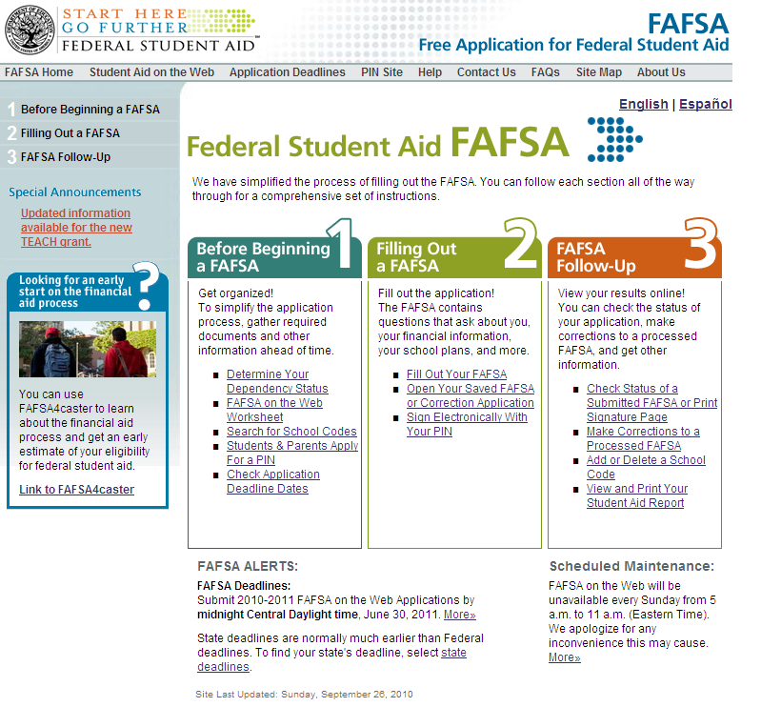
FAFSA Website

Slide 26
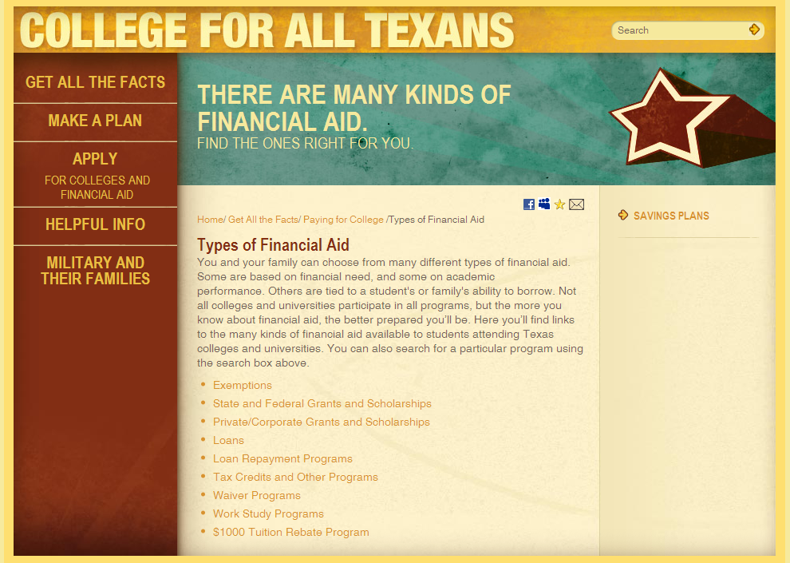

Slide 27


Slide 28
Parent’s Role in the Financial Aid Process
Provide necessary financial information for FAFSA or on scholarship forms, if needed
Check family information covered in application or in essays
Encourage student to make scholarship search a part-time job
Allow student to do their own research and complete their own applications
Encourage students to come in and talk to their counselor or college rep if they have questions. Phone calls from parents are nice, but do not teach the student to advocate for themselves.

Slide 29
Other ways to save…
AP Courses – score of 3, 4, 5 for college credit.
CLEP – required score varies by college for credit.
Dual Enrollment – NCTC
Know your major as soon as possible. Do not waste time and money on courses that are not required for graduation.

Slide 30
On the lighter side:
Dear Dad,
$chool is really great. I am making lot$ of friend$ and $tudying very hard. With all my $tuff, I $imply can’t think of anything I need, $o if you would like, you can ju$t $end me a card, a$ I would love to hear from you.
Love,
Your $on

Slide 31
Dear Son,
I kNOw that astroNOmy, ecoNOmics, and oceaNOgraphy are eNOugh to keep even an hoNOr student busy. Do NOt forget that the pursuit of kNOwledge is a NOble task, and you can never study eNOugh.
Love,
Dad

Slide 32
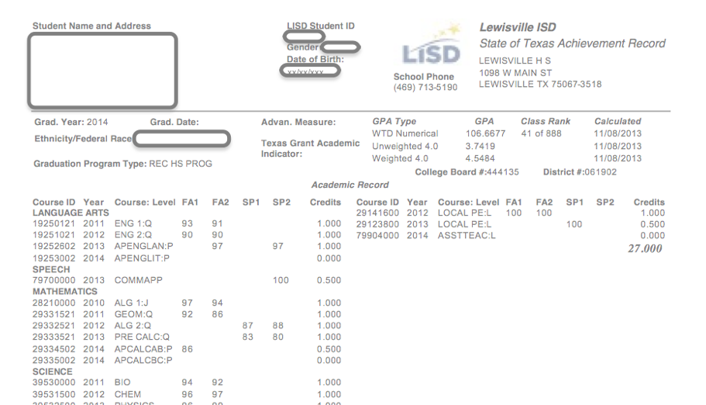

Slide 33
