Slide 1
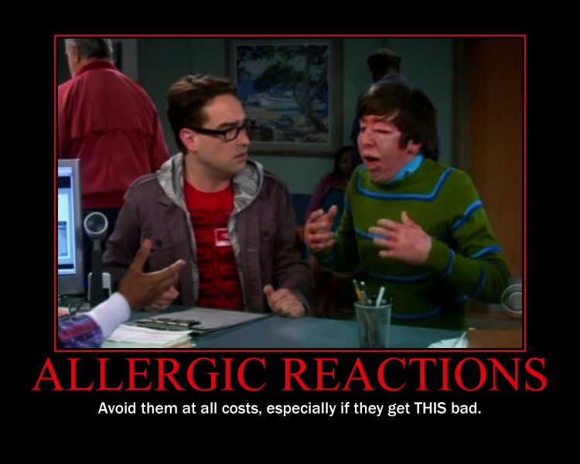
Life Threatening

Slide 2
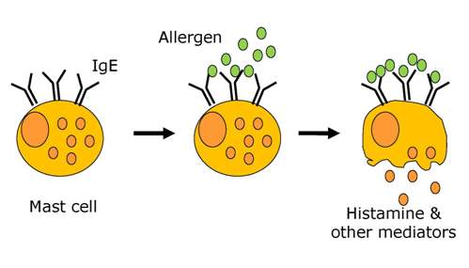
What is a Food Allergy?
The immune system mistakes the food protein as “bad” and releases chemicals, including histamines that result in physical symptoms
Symptoms include hives, swelling, trouble breathing

Slide 3
Prevalence
The CDC currently estimates that four out of every 100 kids have a food allergy with prevalence increasing.
Although we can be allergic to any food, eight foods cause 90% of food allergies in the United States
  Milk, eggs, tree nuts, peanuts, wheat, soy , fish and shellfish

Slide 4


Prevalence
Although we can be allergic to any food, eight foods cause 90% of food allergies in the United States
  Milk, eggs, tree nuts, peanuts, wheat, soy , fish and shellfish

Slide 5
Food Intolerance
Unlike a food allergy, a food intolerance does NOT involve the immune system and is not life threatening.
An example of a food intolerance is lactose intolerance. Lactose, found in milk, may cause GI discomfort, but the immune system is not involved and it is not life-threatening.

Slide 6
Signs and Symptoms of a Severe Food Allergy Reaction: Anaphylaxis
Body System | Sign/Symptom
Mouth | Tingling, itching, swelling of tongue, lips or mouth
Throat | Tightness of throat, tickling in back of throat; hoarseness or change in voice
Nose/Eyes/Ears | Runny, itchy nose; redness and/or swelling of eyes; throbbing in ears
Lungs | Shortness of breath, shallow, repetitive cough; wheezing
Stomach | Nausea, vomiting, diarrhea and cramps
Skin | Itchy rash, hives; swelling of face or extremities; facial flushing
Heart | Weak pulse, palpitations, fainting , blue tinge to lips, face, or nail beds; paleness

Slide 7
Anaphylaxis
Serious allergic reaction that is rapid in onset and may cause death.
More than one body system are involved – mouth, throat, nose, eyes, ears, lung, stomach, skin, heart, and brain.
The most dangerous symptoms include breathing difficulties and a drop in blood pressure or shock.

Slide 8
What Do We Do to Protect the Students With Life Threatening Food Allergies?
Identify students with life-threatening allergies; asked on enrollment and every year in health and emergency card
Confirm the allergy, including the severity, with documentation from a physician
Develop a plan which includes:
  Emergency Action Plan
  504 Plan
    Food Allergy Action Plan
  Individualized Health Plan

Slide 9
What Do We Do to Protect the Students With Life Threatening Food Allergies?
The goal for all of the plans is to:
  Reduce exposure to the allergen
  Provide emergency protocols in the event of exposure

Slide 10
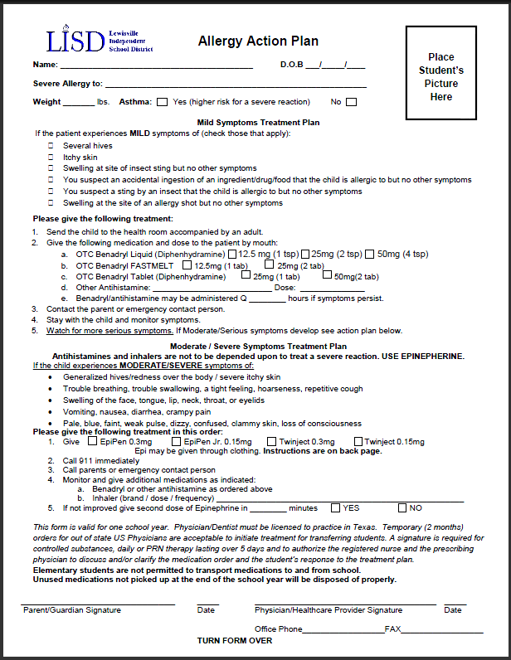
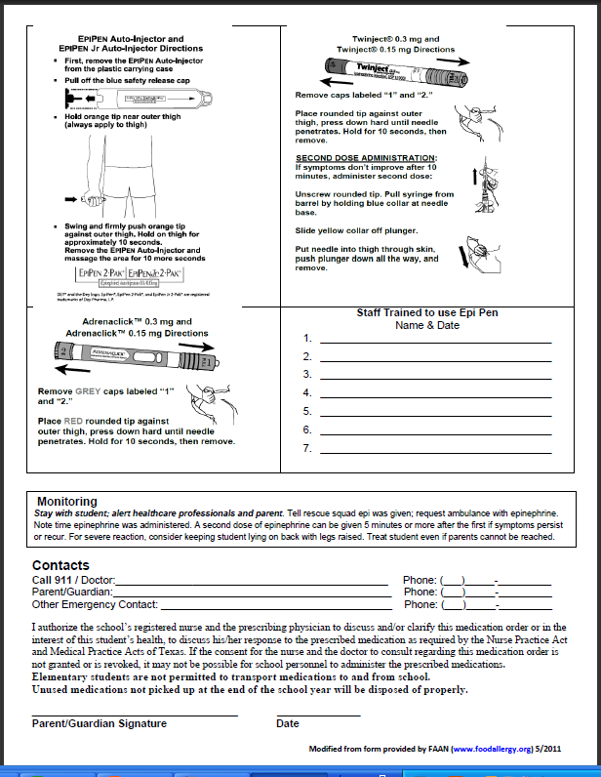
Emergency Action Plan

Slide 11
What to do if a reaction occurs
Administer the epi-pen as quickly as possible.
If the only epi-pen is in the clinic, contact the RN immediately
Call 911.
Call the parents.
Those involved will complete the Report of Epinephrine Administration and submit to the building administrator and the Supervisor of Health Services.
Debrief and adjust the EAP as needed.

Slide 12
How to Use the Epi-pen
Please watch the video that follows for a demonstration on how to use the Epi-pen.

Slide 13
It is imperative that we avoid:
Endangering
Isolating
Stigmatizing
Or harassing
the student with food allergies.

Slide 14

Thank You for helping to keep our students safe!

